Slide 1
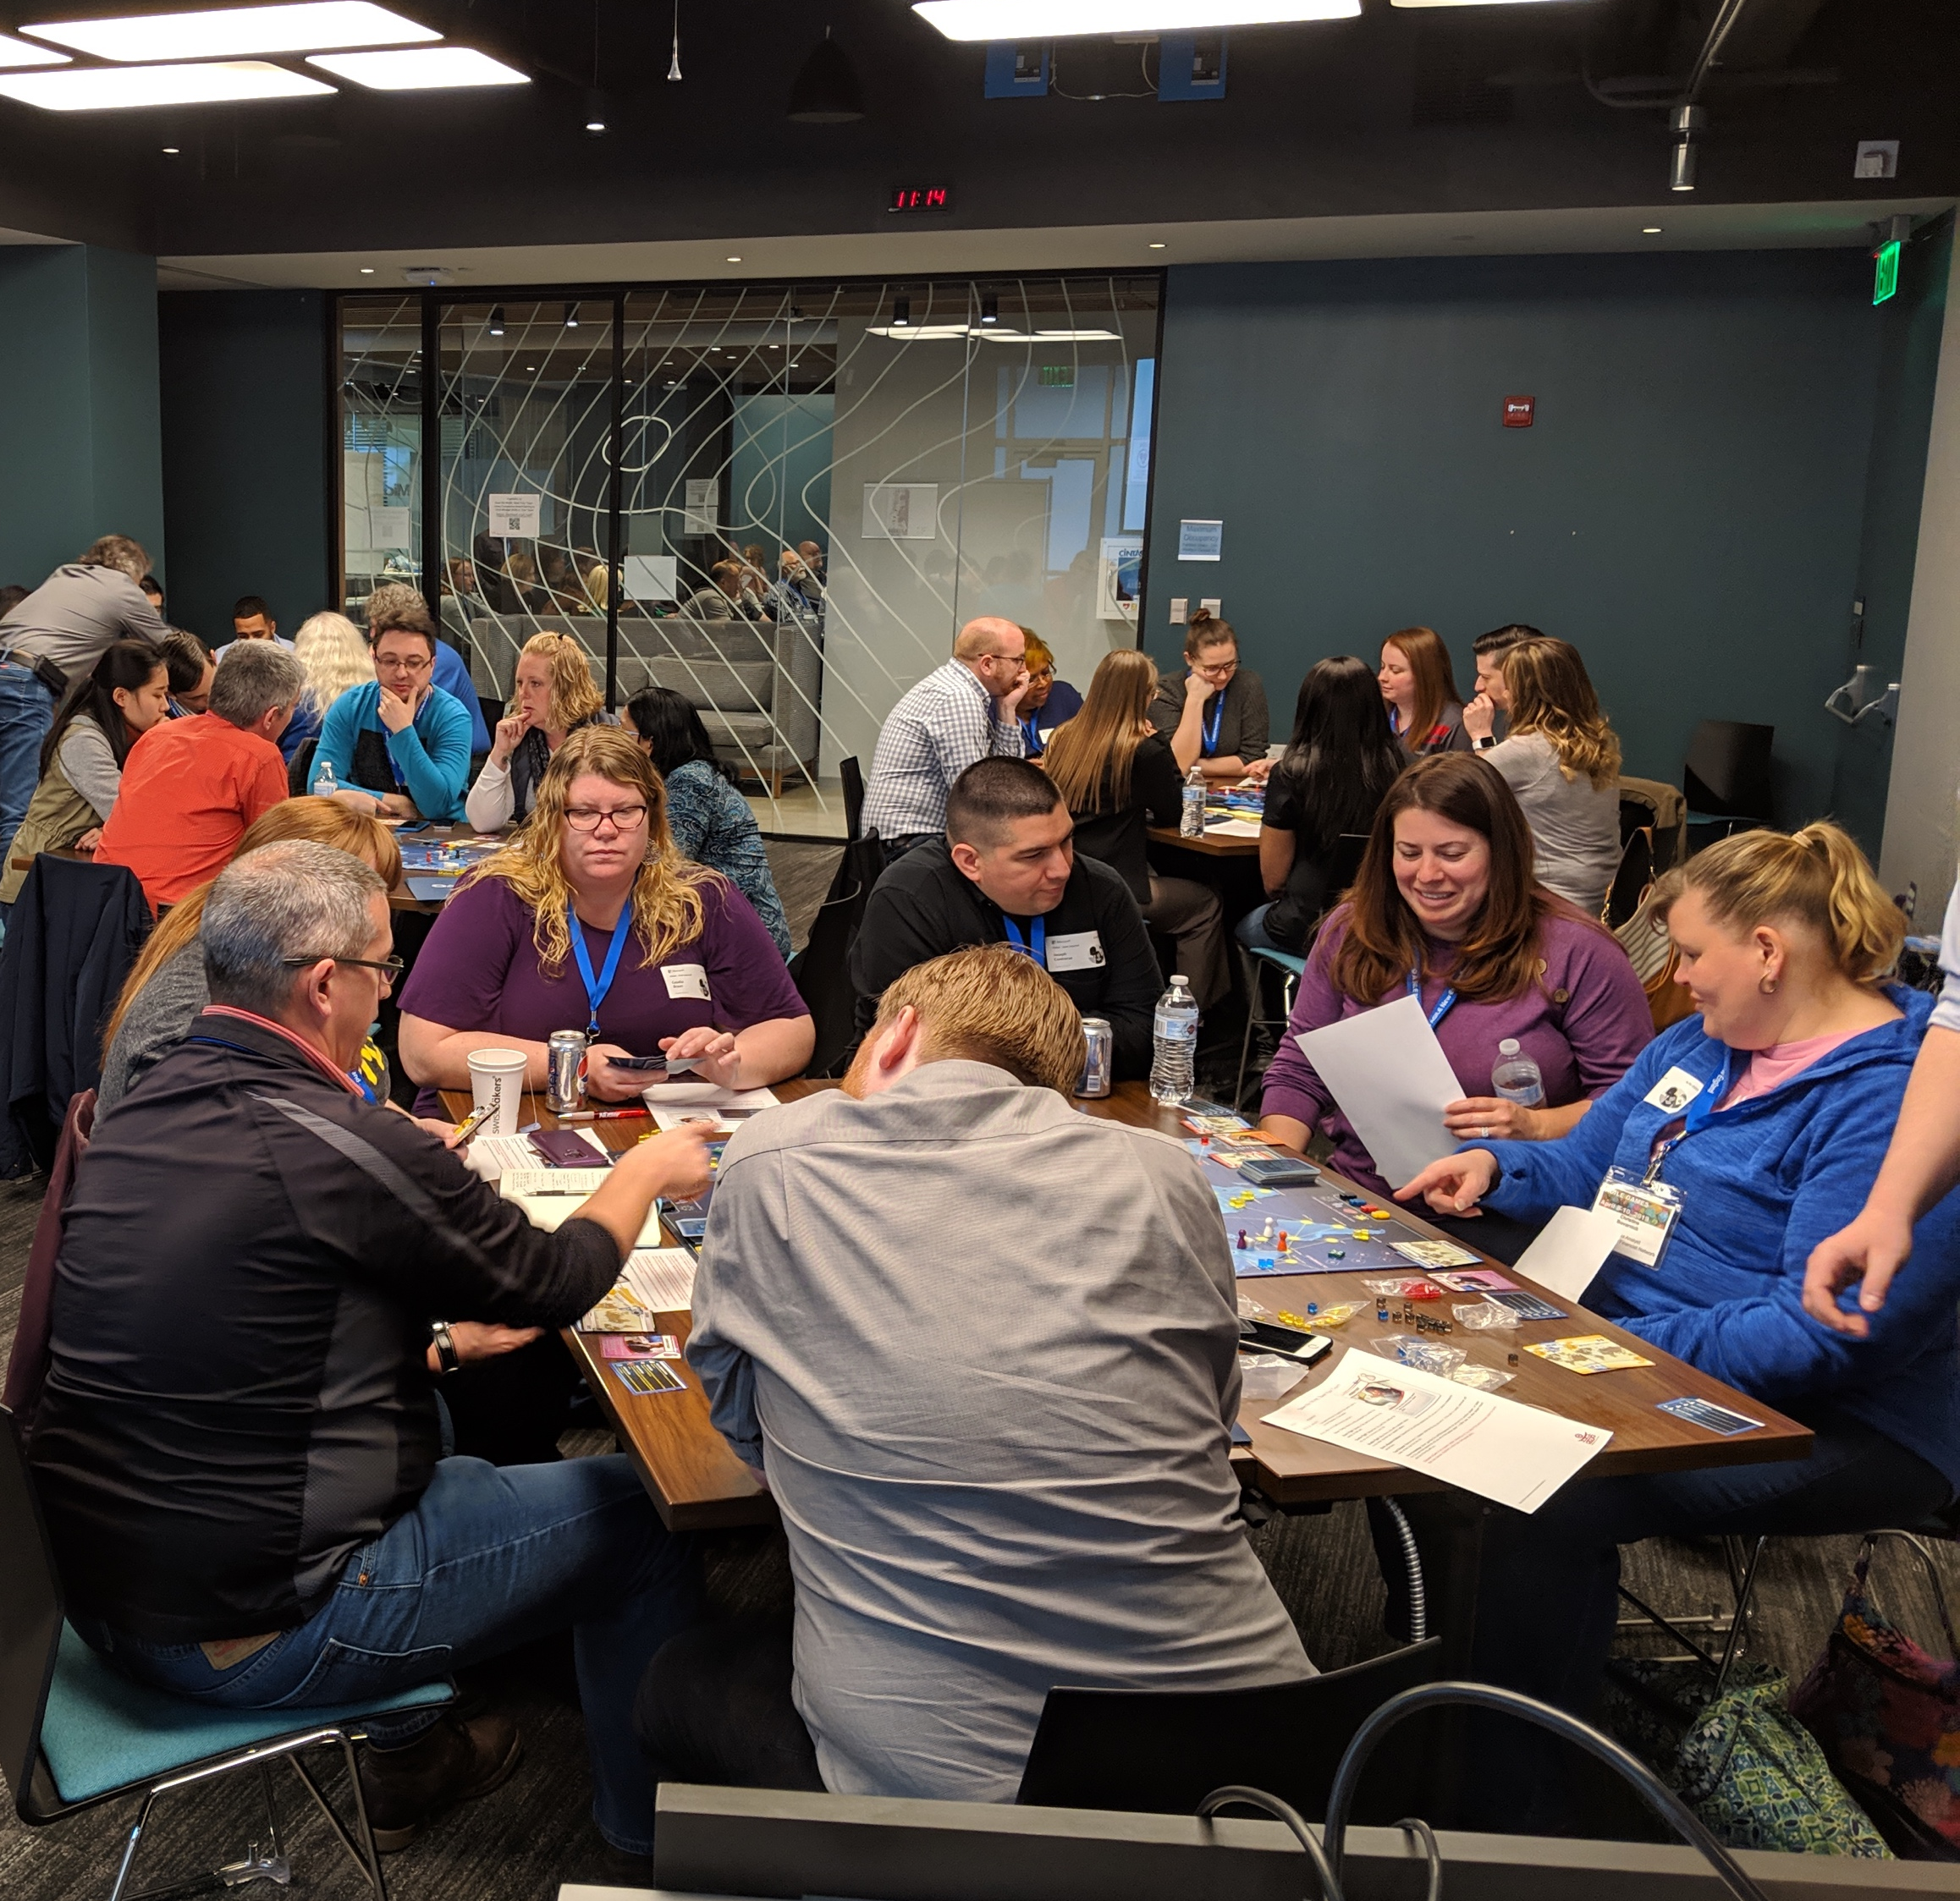
Save the World, Save Your Team - Shifting Mindsets through Cooperative Board Gaming

Slide 2
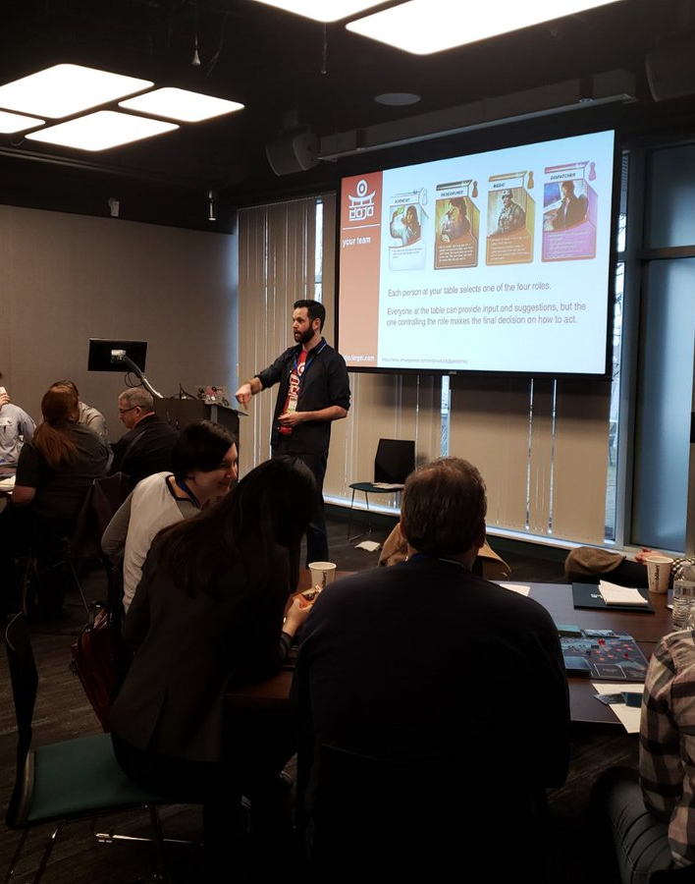
Chris Diller
Leadership Coach and Agilist
Scrum Alliance CTC
International Coaching Federation ACC

Slide 3
our time together
Learning Objectives
Intro to Pandemic
Game on!
Retrospective / Discussion
Questions / Close

Slide 4
learning objectives
As a workshop participant, I want to:
Explain how cooperative board gaming can be used as a retrospective technique so that I can improve my teams.
Describe how to relate cooperative board gaming to the cooperative nature of my team's work so that I can help them reflect on their own actions.
Facilitate a cooperative board gaming workshop of my own so that I can help shift the mindset of my team, company, or client.

Slide 5
intro to Pandemic
Pandemic from Z-Man Games
https://www.zmangames.com/en/products/pandemic/
Notes:
In Pandemic, you and your fellow players are specialists on a team from the Centers for Disease Control. You must work together to develop cures and prevent disease outbreaks before 4 deadly diseases contaminate all of humanity.
A lot more fun to think about before March of 2020

Slide 6
intro to Pandemic
Goal: Discover cures for all four diseases
The team fails if:
  Eight outbreaks occur (overly high infection rate in a city)
  Not enough disease cubes are left when needed (disease has spread too far)
  Not enough player cards are left when needed (ran out of time)
https://www.zmangames.com/en/products/pandemic/

Slide 7
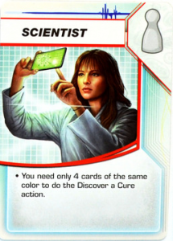
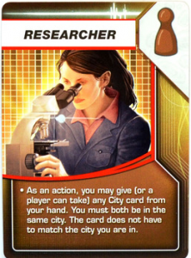
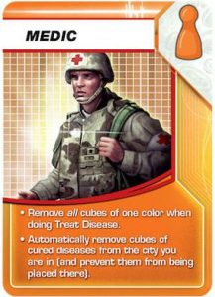
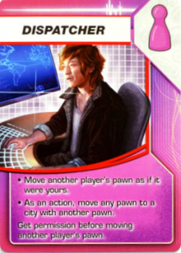
the team
Each person selects one of the four roles.
Everyone can provide input and suggestions, but the one controlling the role makes the final decision on how to act.
https://www.zmangames.com/en/products/pandemic/
Notes:
If you have more than 4 in a team:
you can rotate new players in
Add another game
Two people can pair up to be the “Research Team” or “Medical Team” and jointly make decisions for the role
If you have fewer than 4 at your table
look for extra people at other tables
the group can jointly play as the Dispatcher
the group can play without the Dispatcher

Slide 8
on each player turn
Complete four actions (move, treat disease, trade cards, discover a cure, etc)
Draw two Player Cards from the Player Deck
Infect Cities
https://www.zmangames.com/en/products/pandemic/

Slide 9
questions to ponder
What similarities do you notice between Pandemic and Agile development? What differences?
Is the team at your table an Agile team? Are they more or less Agile than your team at work? How so? Why?

Slide 10
game on!
You’ll have 55 minutes for gameplay.
If you get stuck on the rules, make your best judgment and move forward (better to keep playing than sit and wait).
I’ll be walking around to help answer questions.
Rotate people in if you have more than four at your table.
Take notes and feel free to break for discussions as they come up!

Slide 11
retro
At your tables…
Revisit the questions from the worksheet
Talk about the differences / similarities between gameplay and work situations

Slide 12
ending where we started
As a workshop participant, I want to:
Explain how cooperative board gaming can be used as a retrospective technique so that I can improve my teams.
Describe how to relate cooperative board gaming to the cooperative nature of my team's work so that I can help them reflect on their own actions.
Facilitate a cooperative board gaming workshop of my own so that I can help shift the mindset of my team, company, or client.

Slide 13
questions?
Photo by Evan Dennis on Unsplash

Slide 14

keep in touch…
@cddiller
/in/cddiller
chris@dillercoaching.com
dillercoaching.com/pandemic
Image source: dftba.com

